Slide 1
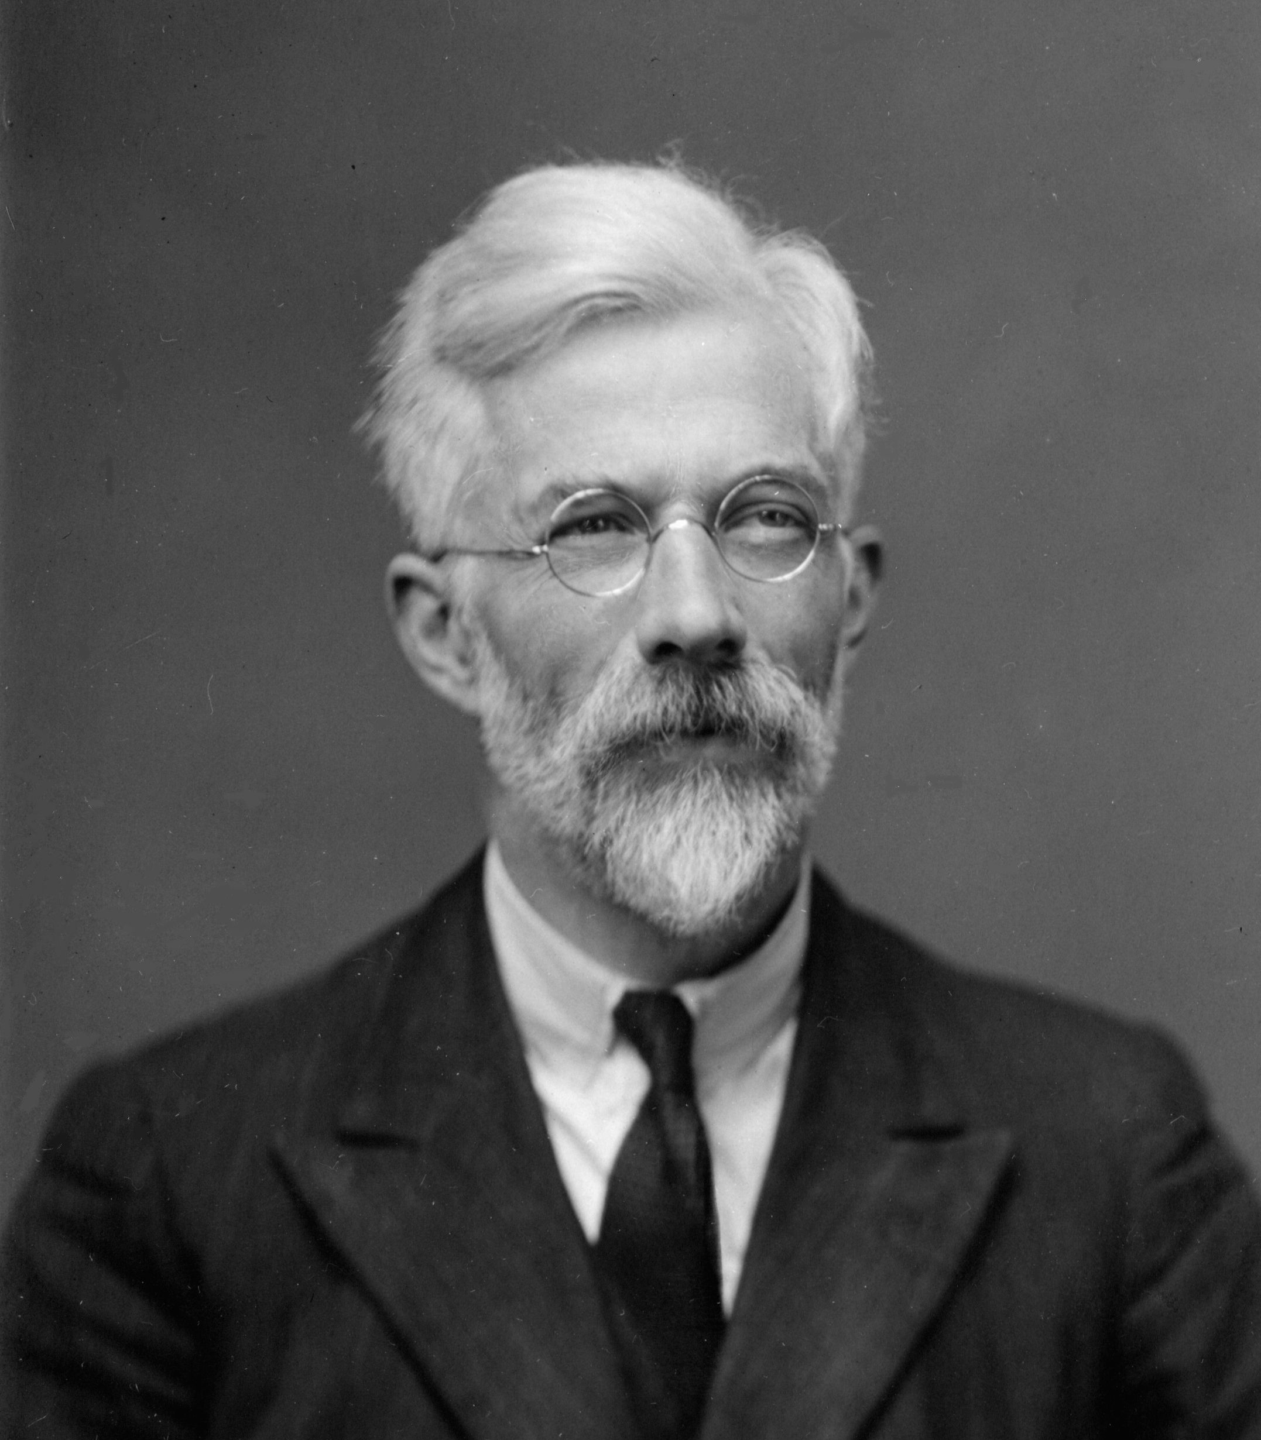

SOEE1475 Statistics and Data Analysis
Lecture 4: Null hypothesis statistical testing
Graeme T. Lloyd

Slide 2

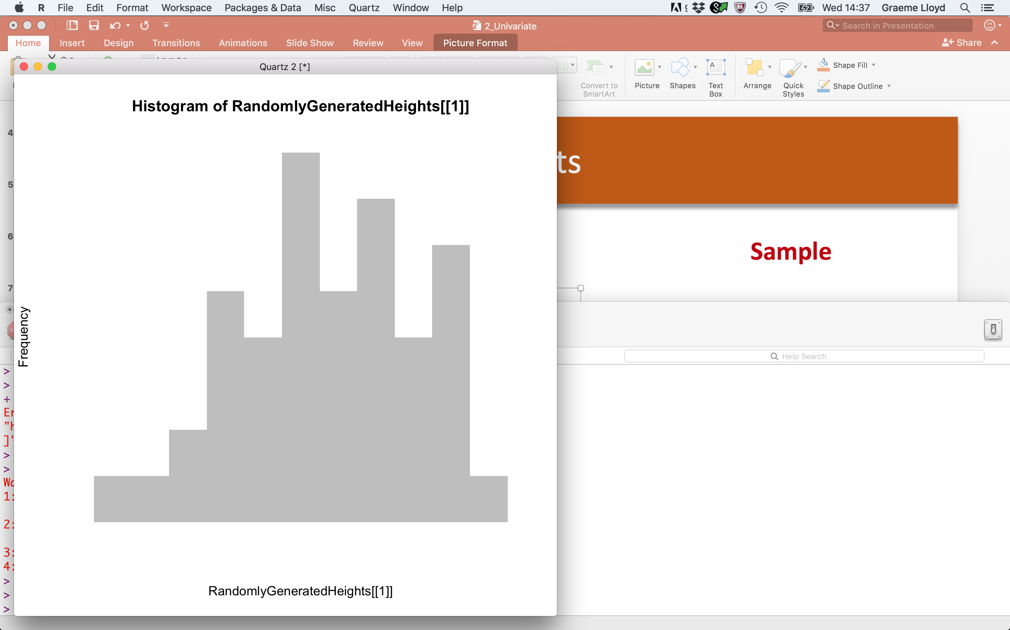
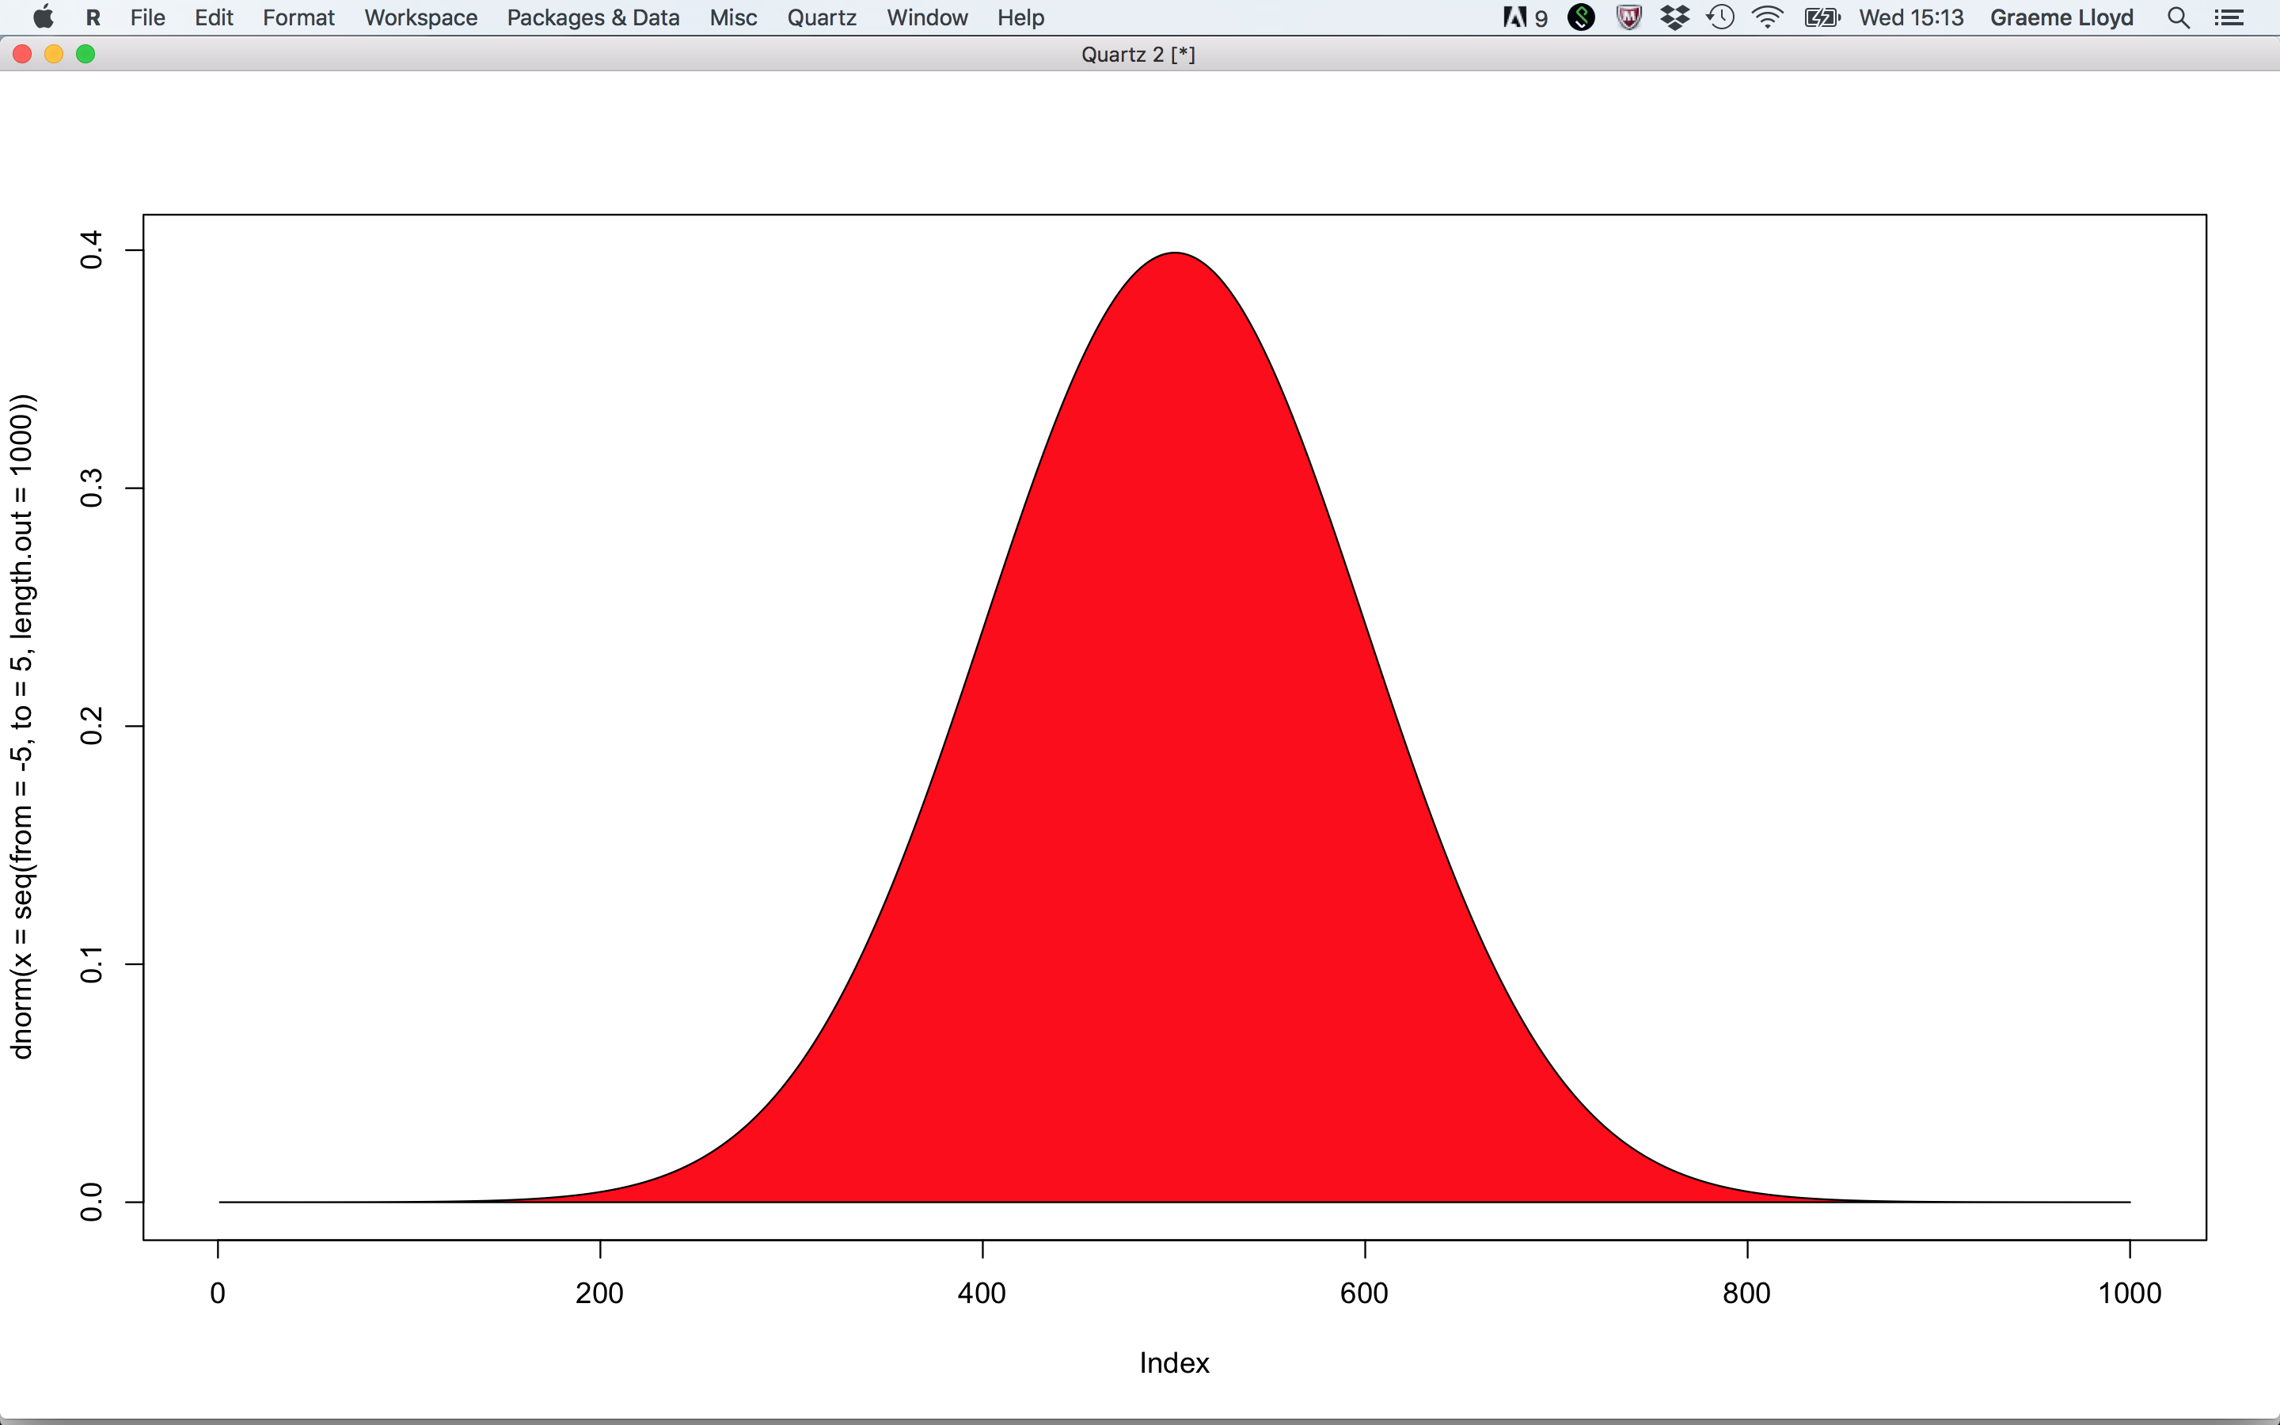
Univariate data
Population
Sample
Notes:
With univariate data we ar interested in what we can say about the population from the sample

Slide 3
Bivariate data
y
x
Notes:
With bivariate data we are interested in the relationships between two variables

Slide 4
Future
Multivariate data
Temporal, spatial, and directional data
Notes:
In future lectures we will talk about multivariate data and then special kinds of data (spatial, temporal and directional)

Slide 5
Today
Null hypotheses
Confidence and significance levels
Type I and Type II errors
Notes:
Today we are going to look back at what we’ve done but in a new paradigm, null hypotheses

Slide 6
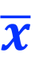
Populations and samples
Population
Sample
Mean
Standard deviation
μ
σ
s
$$\overline{x}$$
Notes:
But first a refresher on terminology, Greek letters for population, roman for sample

Slide 7

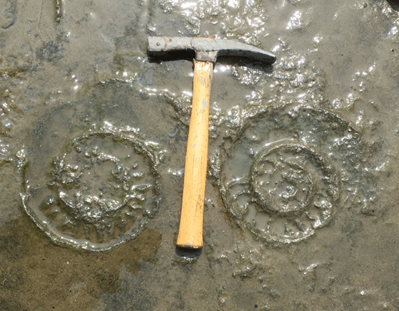

Populations and samples
1
2
3
4
5
6
7
8
9
10
A
B
C
D
E
10m
F
G
H
I
J
10m
Notes:
For our ammonite data we effectively have multiple samples from the same population

Slide 8
Populations and samples
1
2
3
4
5
6
7
8
9
10
A
B
C
D
E
100 samples
10m
F
G
H
I
J
10m
Notes:
100 total samples in fact

Slide 9
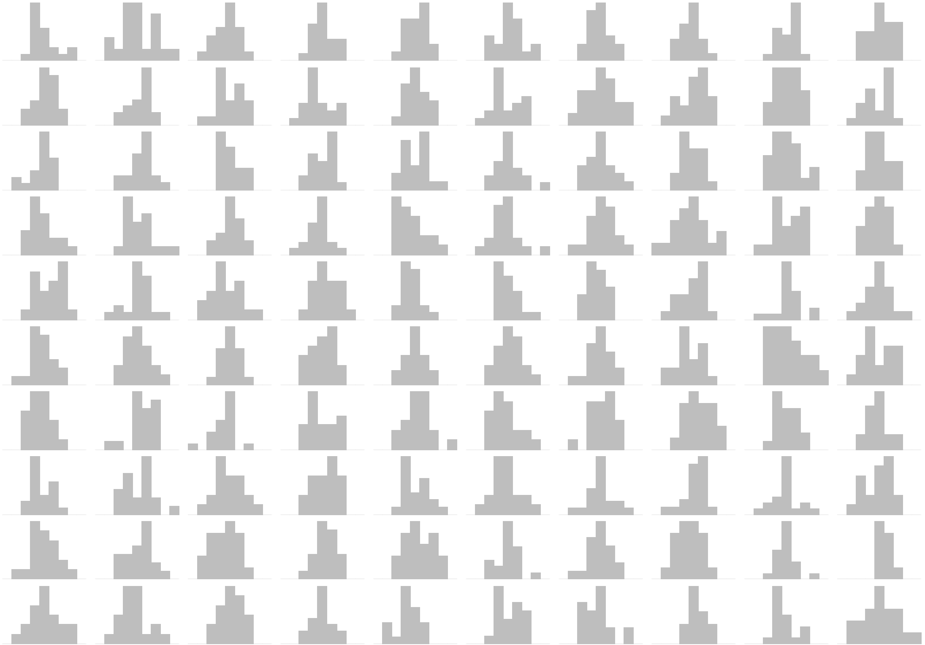
Populations and samples
Notes:
Here are the 100 quadrats as distributions of ammonite diameters

Slide 10
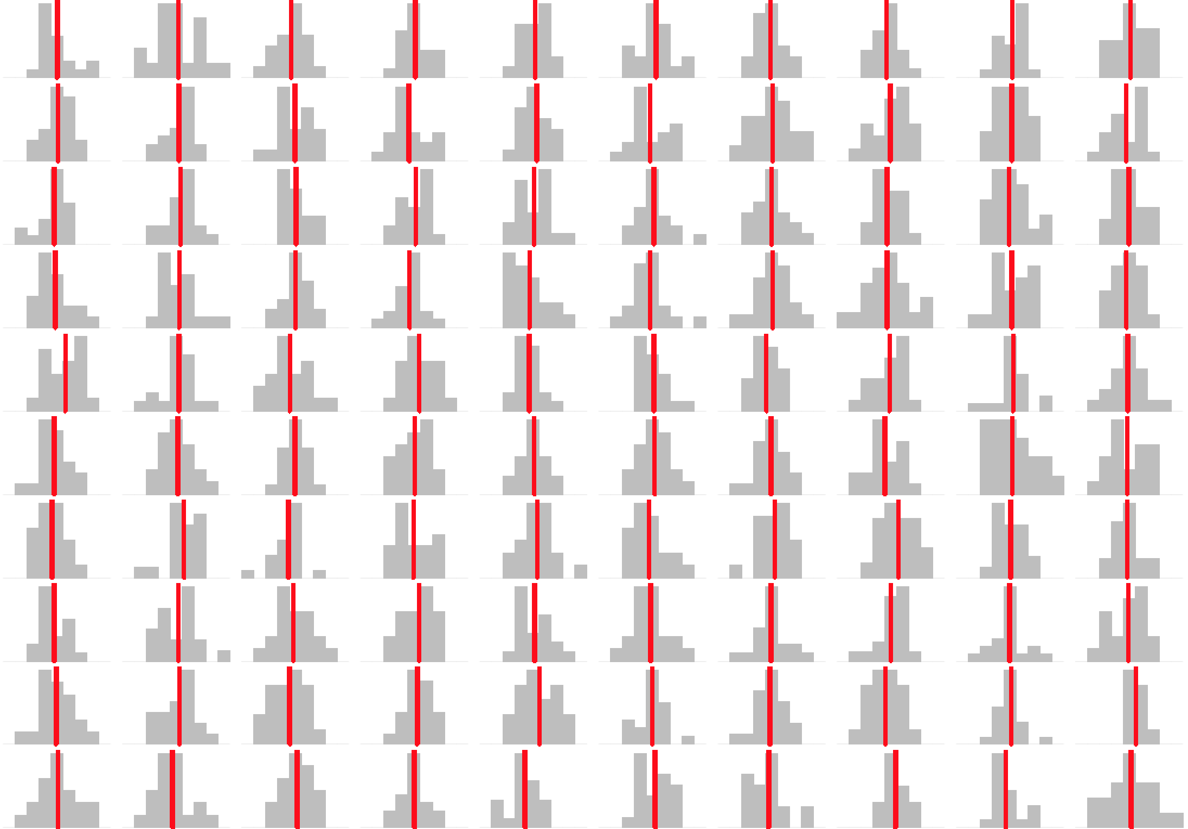
Populations and samples
Notes:
And here are the sample means

Slide 11
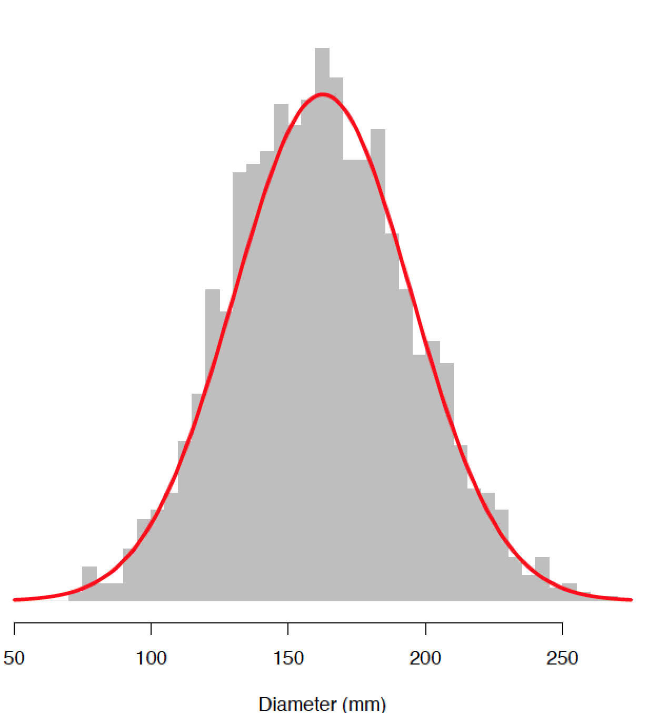
Populations and samples
Pooled sample
Notes:
We can now produce a histogram of all ammonite diamateres by pooling all samples into one large sample

Slide 12
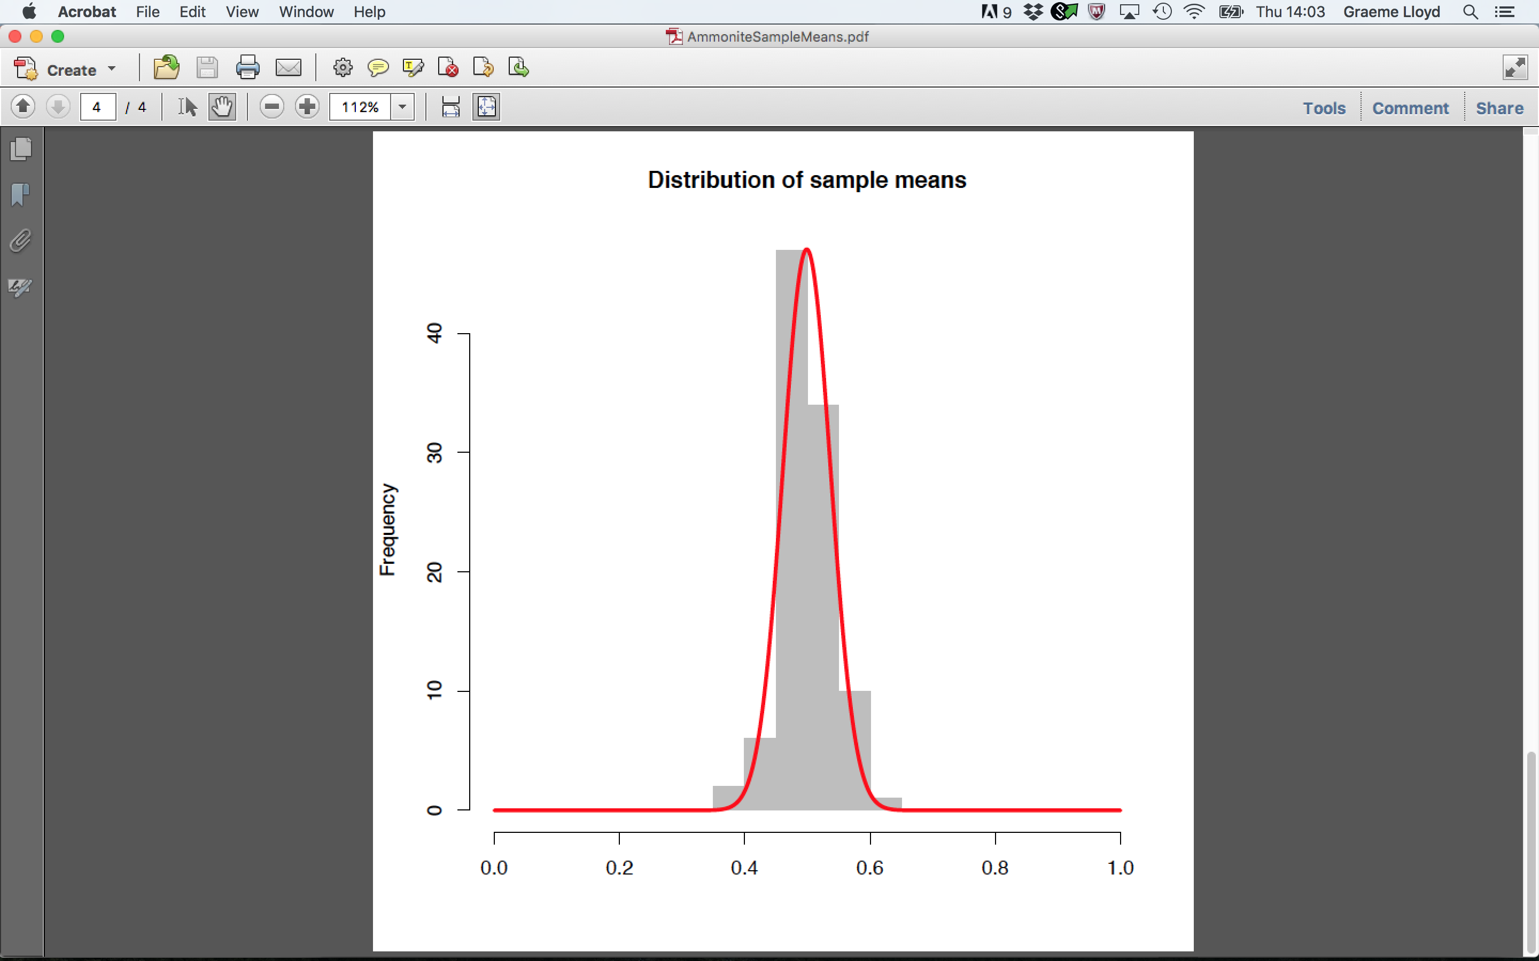
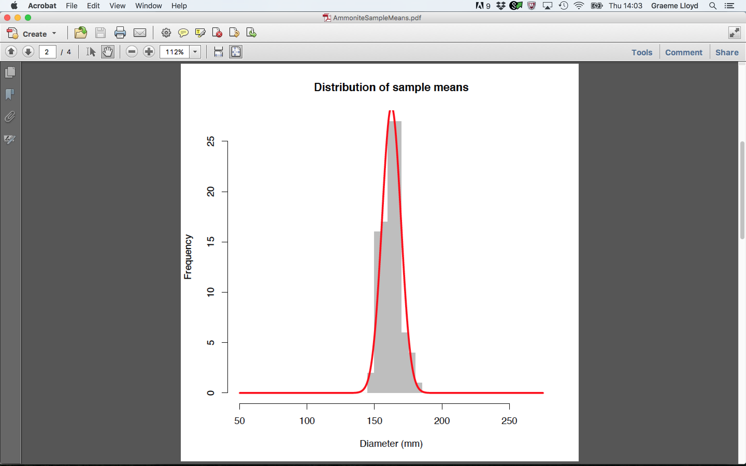
Populations and samples
Pooled sample
Sample means
Notes:
But we can also produce a sample of our sample means. Note that this is also normally distributed, but has a lower variance

Slide 13
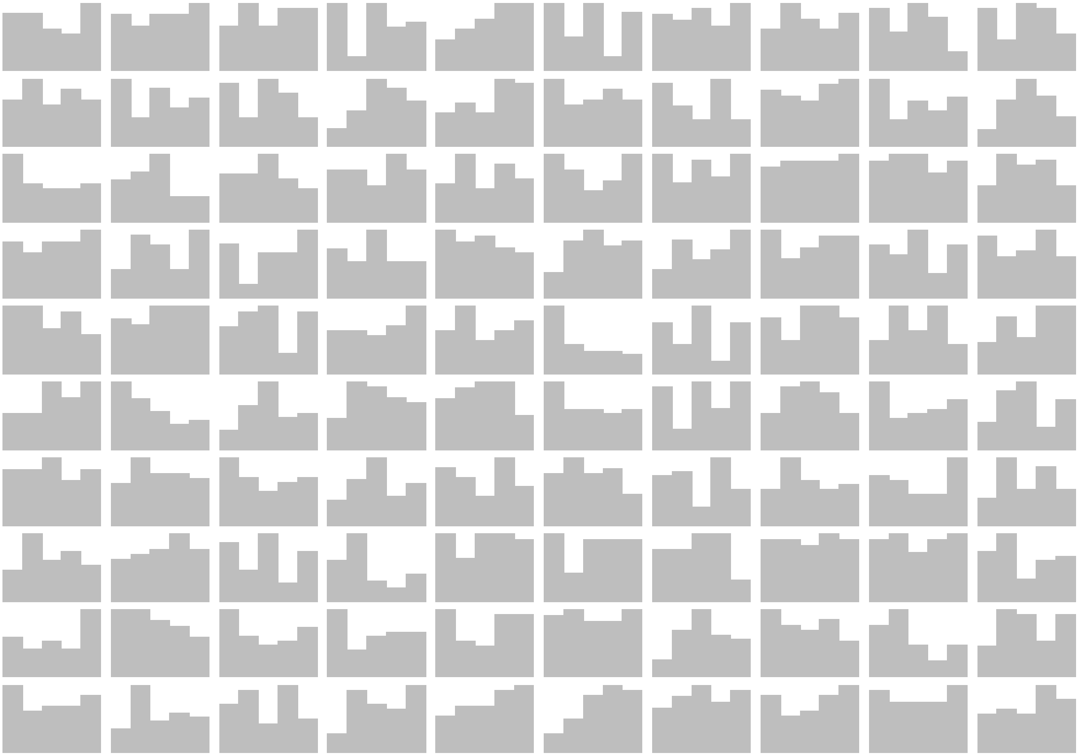
Populations and samples
Notes:
What if we consider other data? Here are 100 data sets generated by randomly sampling from a continuous uniform distribution

Slide 14
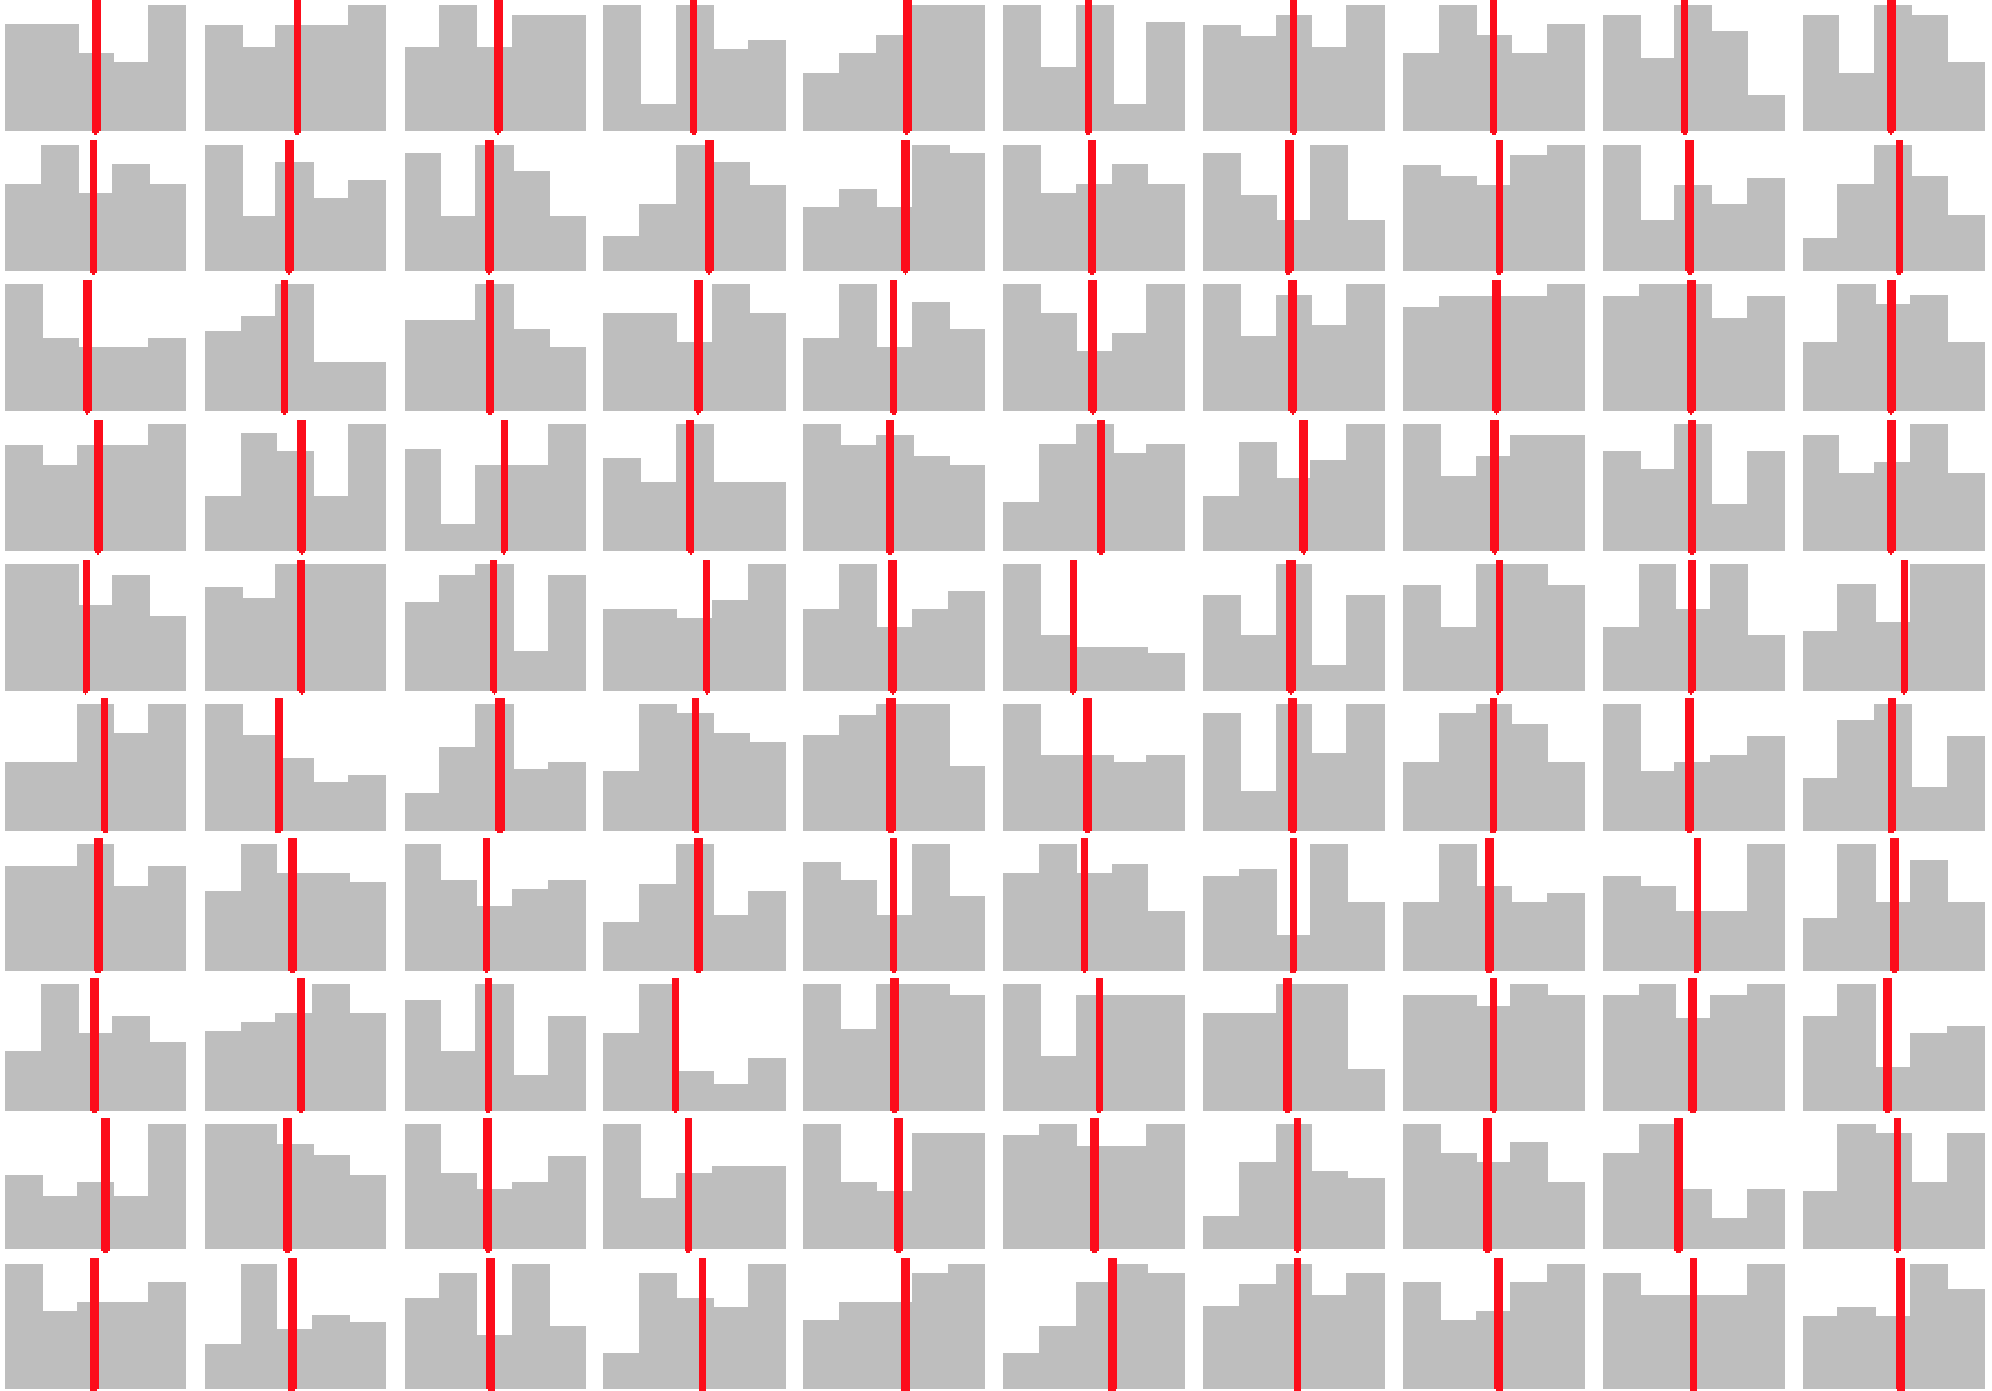
Populations and samples
Notes:
And here are their means. How will these sample means be distributed?

Slide 15
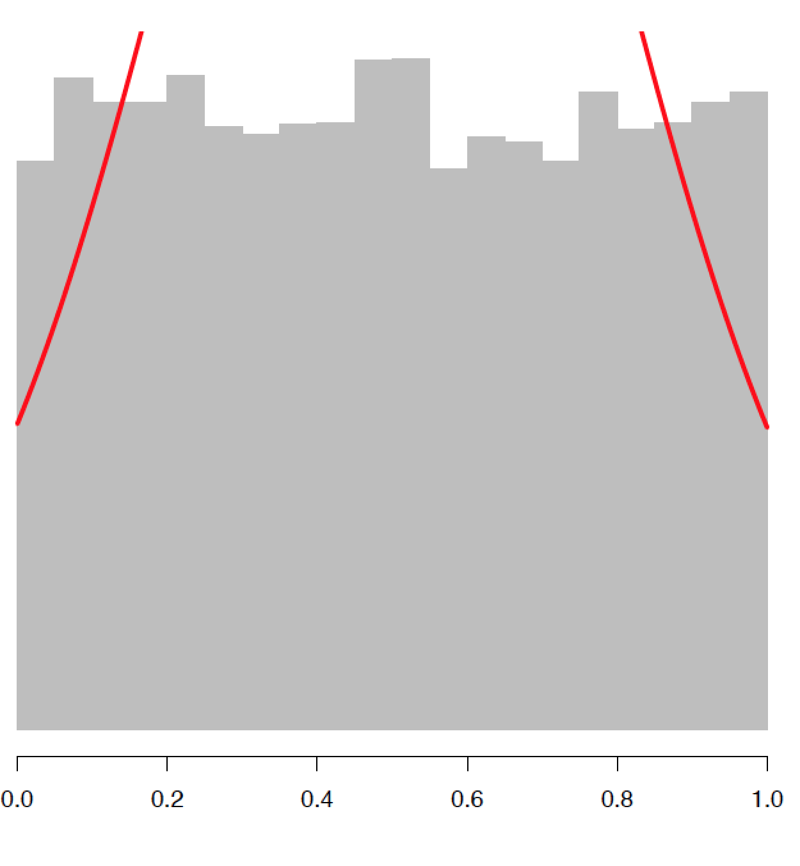
Populations and samples
Pooled sample
Notes:
Again we can pool each sample into a mega sample and we clearly see a uniform distribution (the normal is a bad fit).

Slide 16
Populations and samples
Pooled sample
Sample means
Notes:
But what about the sample means? These appear to fit a normal distribution very well.

Slide 17
Populations and samples – implications
Notes:
What does this mean?

Slide 18
Populations and samples – implications
Sample means are normally distributed
Holds regardless of the distribution of samples; Central Limit Theorem
Notes:
Firstly, sample means are always normally dsitributed, een if the data they derive from are not. This is known as the Central Limit Theorem and is another reason why the normal is so important to statistics

Slide 19
Populations and samples – implications
Sample means are normally distributed
Holds regardless of the distribution of samples; Central Limit Theorem
Mean of sample means ≈ population mean
If we have ∞ samples, mean of sample means = population mean
Notes:
Secondly, the mean of the sample means approximates the population mean, and in an ideal scenario of infinite samples would be exactly the population mean

Slide 20
Populations and samples – implications
Sample means are normally distributed
Holds regardless of the distribution of samples; Central Limit Theorem
Mean of sample means ≈ population mean
If we have ∞ samples, mean of sample means = population mean
Distribution of sample means has its’ own standard deviation
A dispersion metric, standard error of the mean (SEM)
Notes:
Finally, we saw that the distribution of our sample means can be thought of as having it’s own standard deviation, this is known as the standard erro of the mean. This is what we can use to produce confidence intervals.

Slide 21

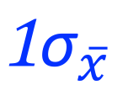
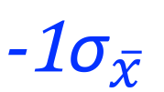
Standard error of the mean, ${\text{σ}}_{\overline{x}}$
Middle
68.2%
$${\text{−1}\text{σ}}_{\overline{x}}$$
$${\text{1}\text{σ}}_{\overline{x}}$$
Notes:
The same general rules apply to this standard deviation as other, i.e., 68.2% of the data falls within plus/minus one sigma of the mean

Slide 22
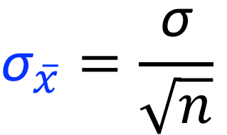
Standard error of the mean, ${\text{σ}}_{\overline{x}}$
$${\text{σ}}_{\overline{x}}=\frac{\text{σ}}{\sqrt{n}}$$
Middle
68.2%
$${\text{−1}\text{σ}}_{\overline{x}}$$
$${\text{1}\text{σ}}_{\overline{x}}$$
Notes:
Equation for the SEM is given as the population mean over the square root of the sample size

Slide 23
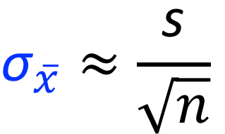
Standard error of the mean, ${\text{σ}}_{\overline{x}}$
$${\text{σ}}_{\overline{x}}=\frac{\text{σ}}{\sqrt{n}}$$
Middle
68.2%
$${\text{σ}}_{\overline{x}}≈\frac{\text{s}}{\sqrt{n}}$$
$${\text{−1}\text{σ}}_{\overline{x}}$$
$${\text{1}\text{σ}}_{\overline{x}}$$
Notes:
However, we will never know the population standard deviation but we can approximate with the sample standard deviation.

Slide 24
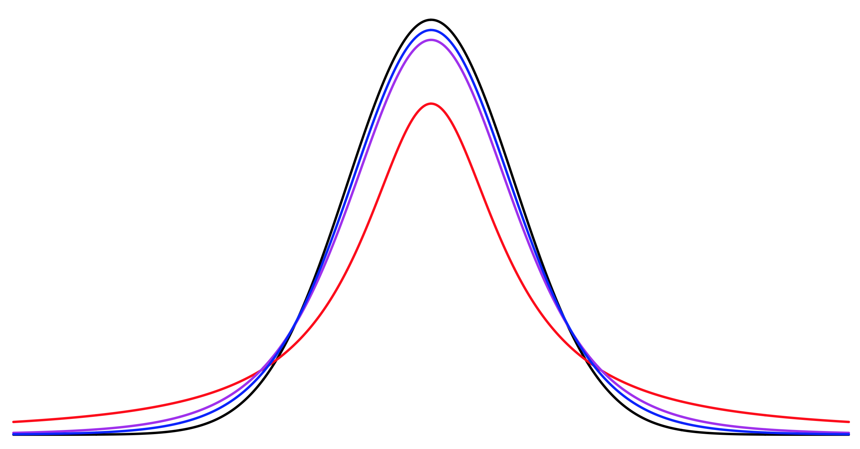
Standard error of the mean, ${\text{σ}}_{\overline{x}}$
t-distribution (n = 2)
Normal distribution
t-distribution (n = 6)
t-distribution (n = 11)
Notes:
In absence of knowing sigma can approximate using the t-distribution we already encountered in univariate statisics

Slide 25
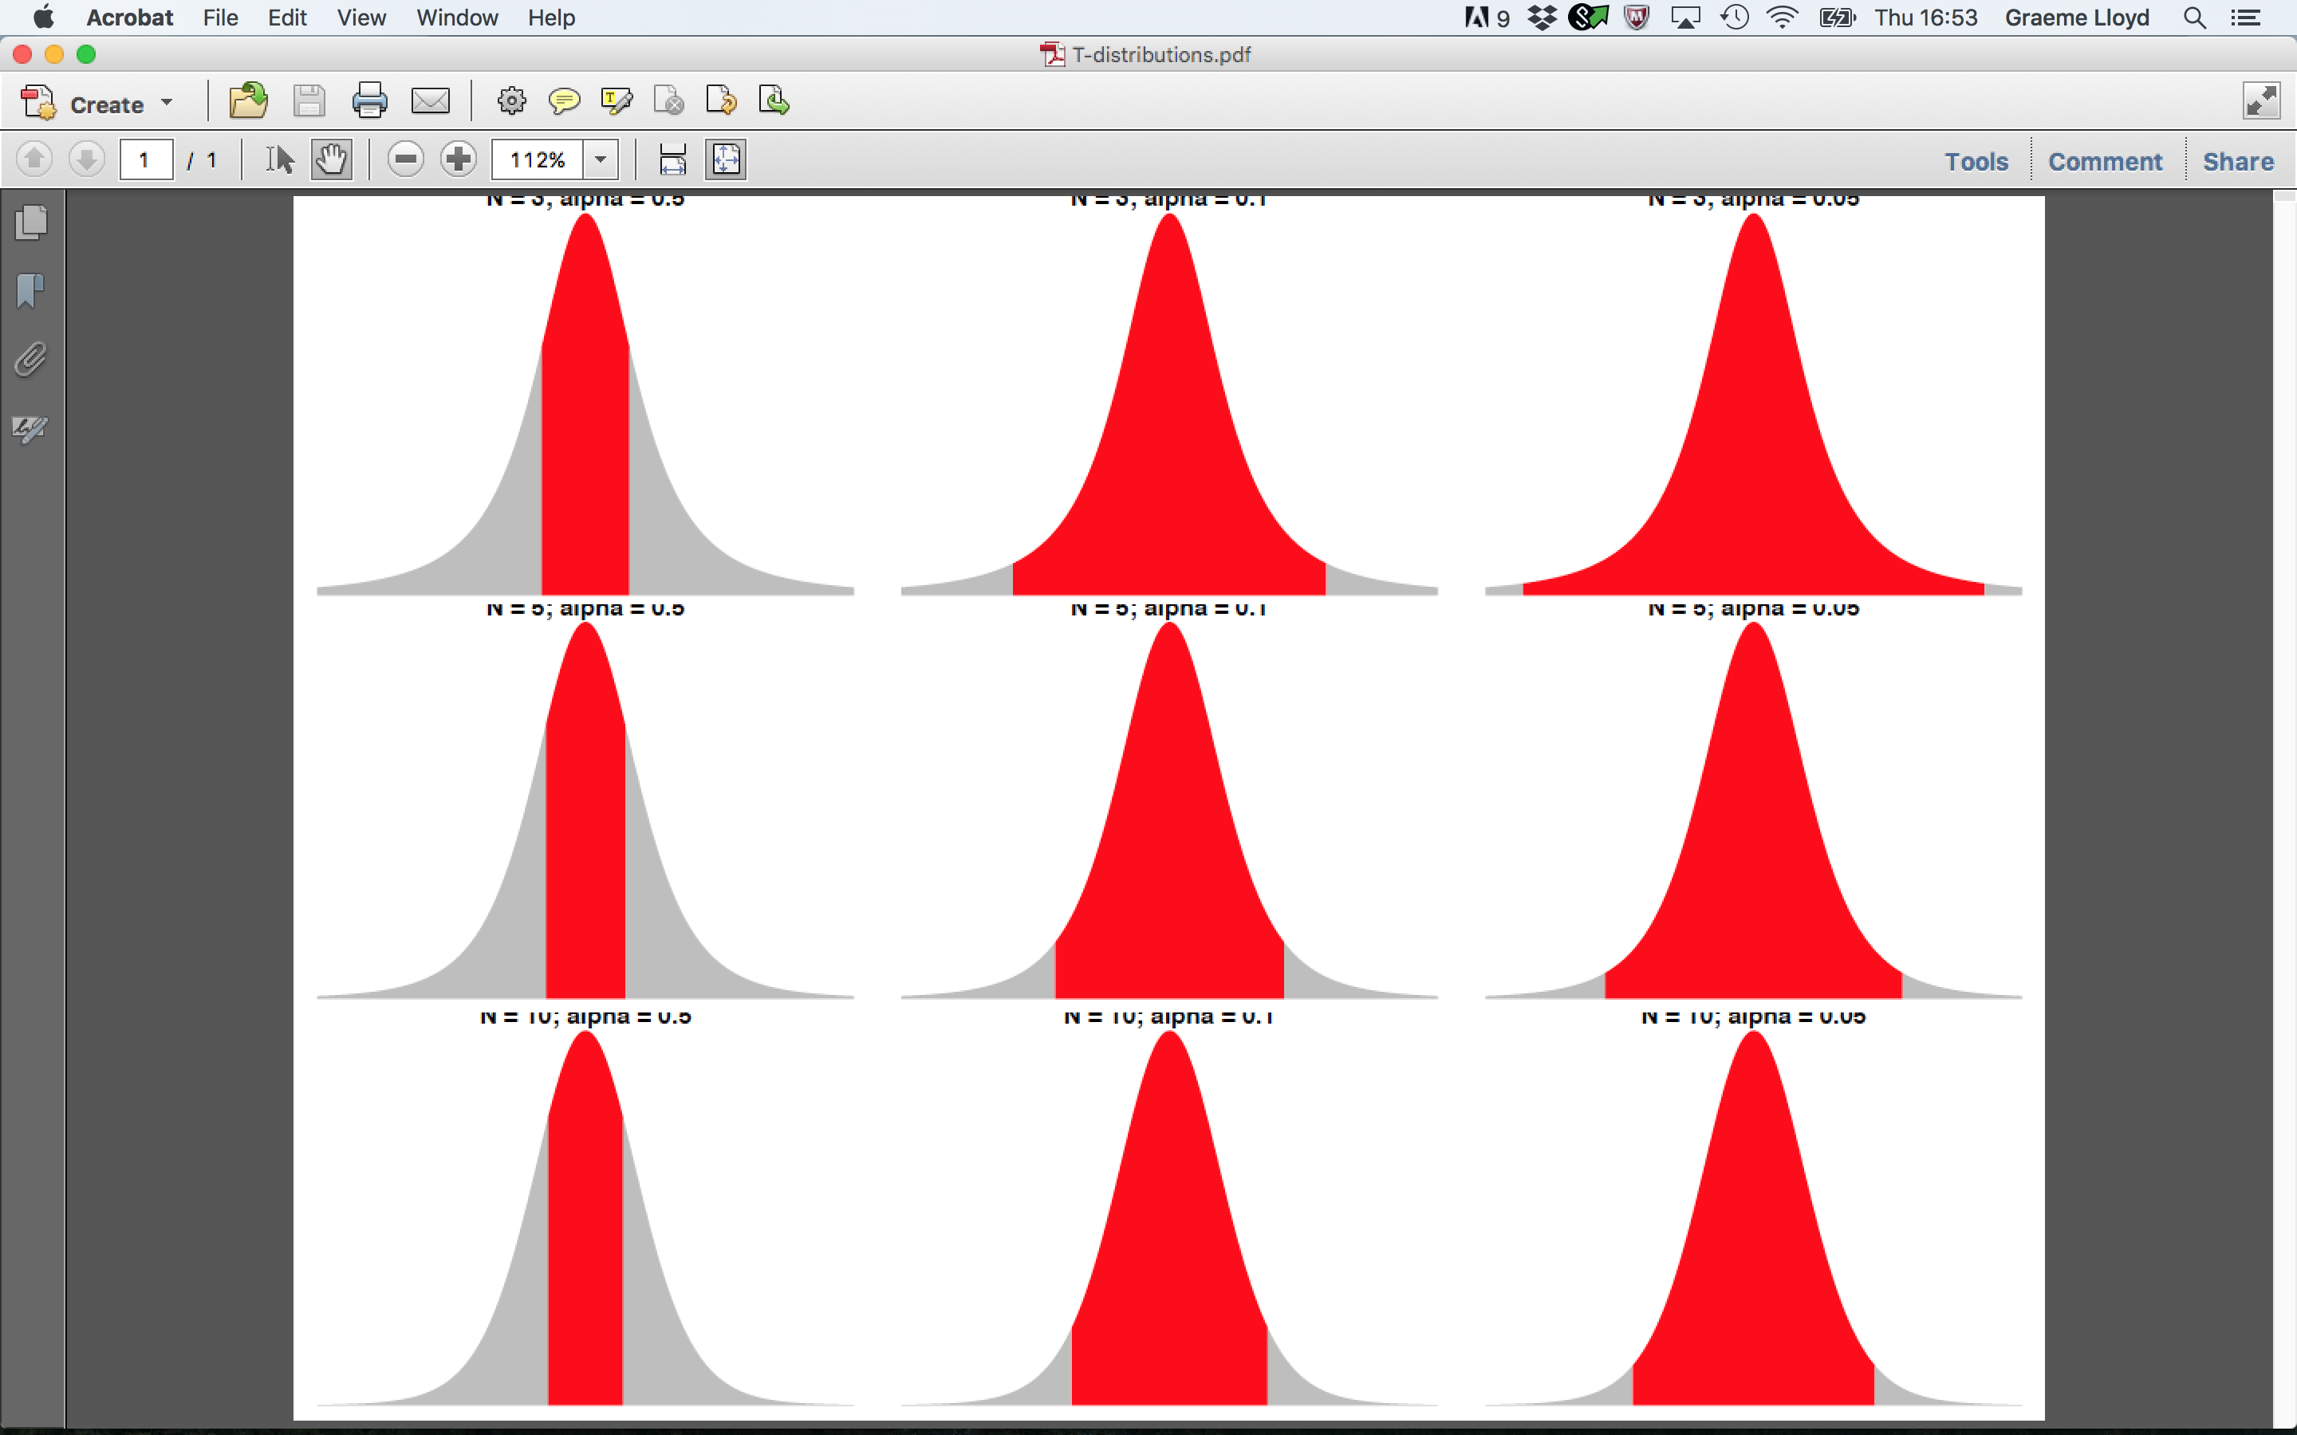

Confidence intervals and ${\text{σ}}_{\overline{x}}$
Conf. = 50%
Conf. = 90%
Conf. = 95%
N = 3
N = 5
N = 10
Notes:
In absence of knowing sigma can approximate using the t-distribution we already encountered

Slide 26
Exercise

Slide 27
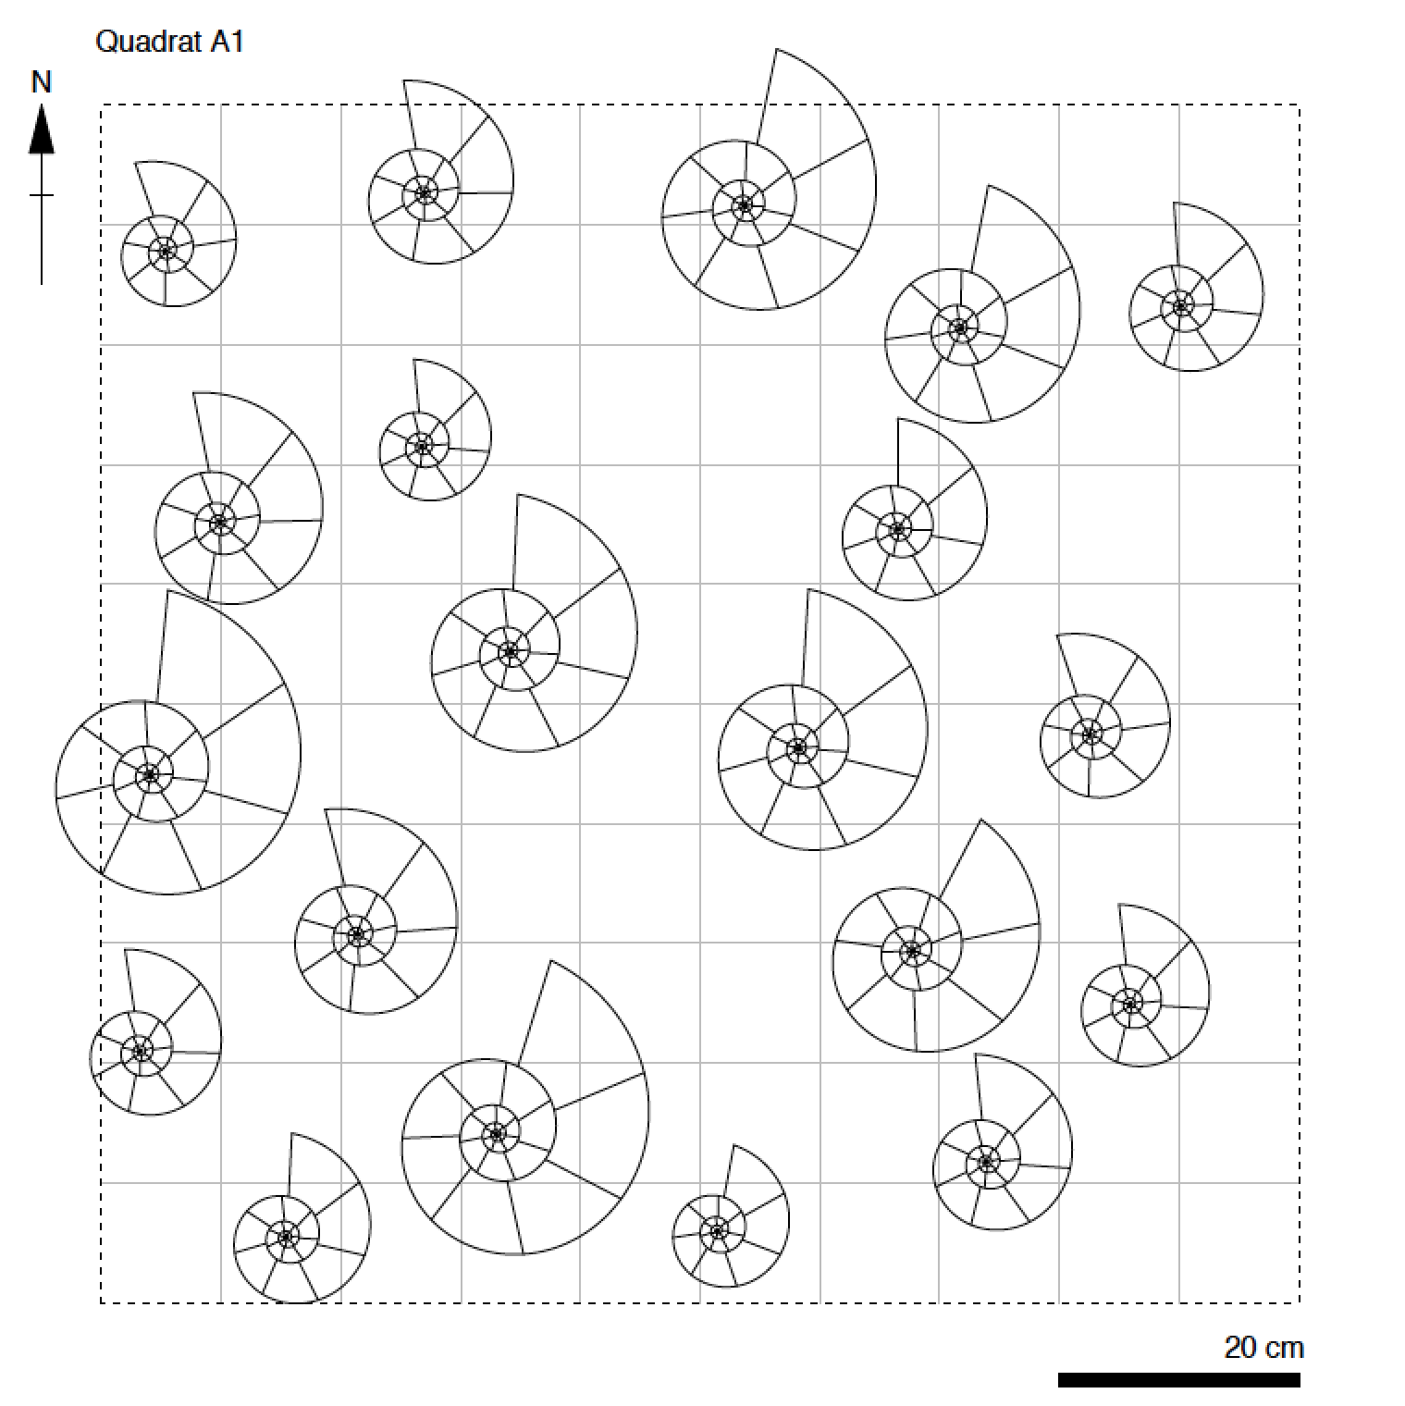
Exercise

Slide 28
Exercise

Slide 29

Exercise

Slide 30
Exercise
p(at least two people in the room share a birthday)

Slide 31
Exercise
Option A
0.0-0.2
Option B
0.2-0.4
p(2+ shared birthdays) =
Option C
0.4-0.6
Option D
0.6-0.8
Option E
0.8-1.0
Notes:
Ask class to pick a range they think the answer falls in (count N people in lecture first)

Slide 32
Exercise
Notes:
Turn off slide and use whiteboard to see if there is a shared birthday / Go through calculation of probability for N people in class

Slide 33
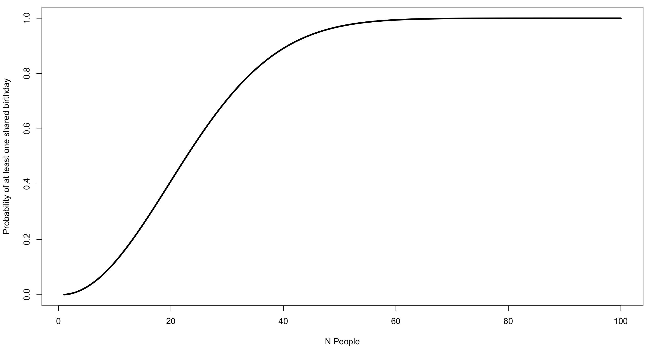
Exercise
Notes:
Graph of probabilities of two people sharing a birthday for N people

Slide 34
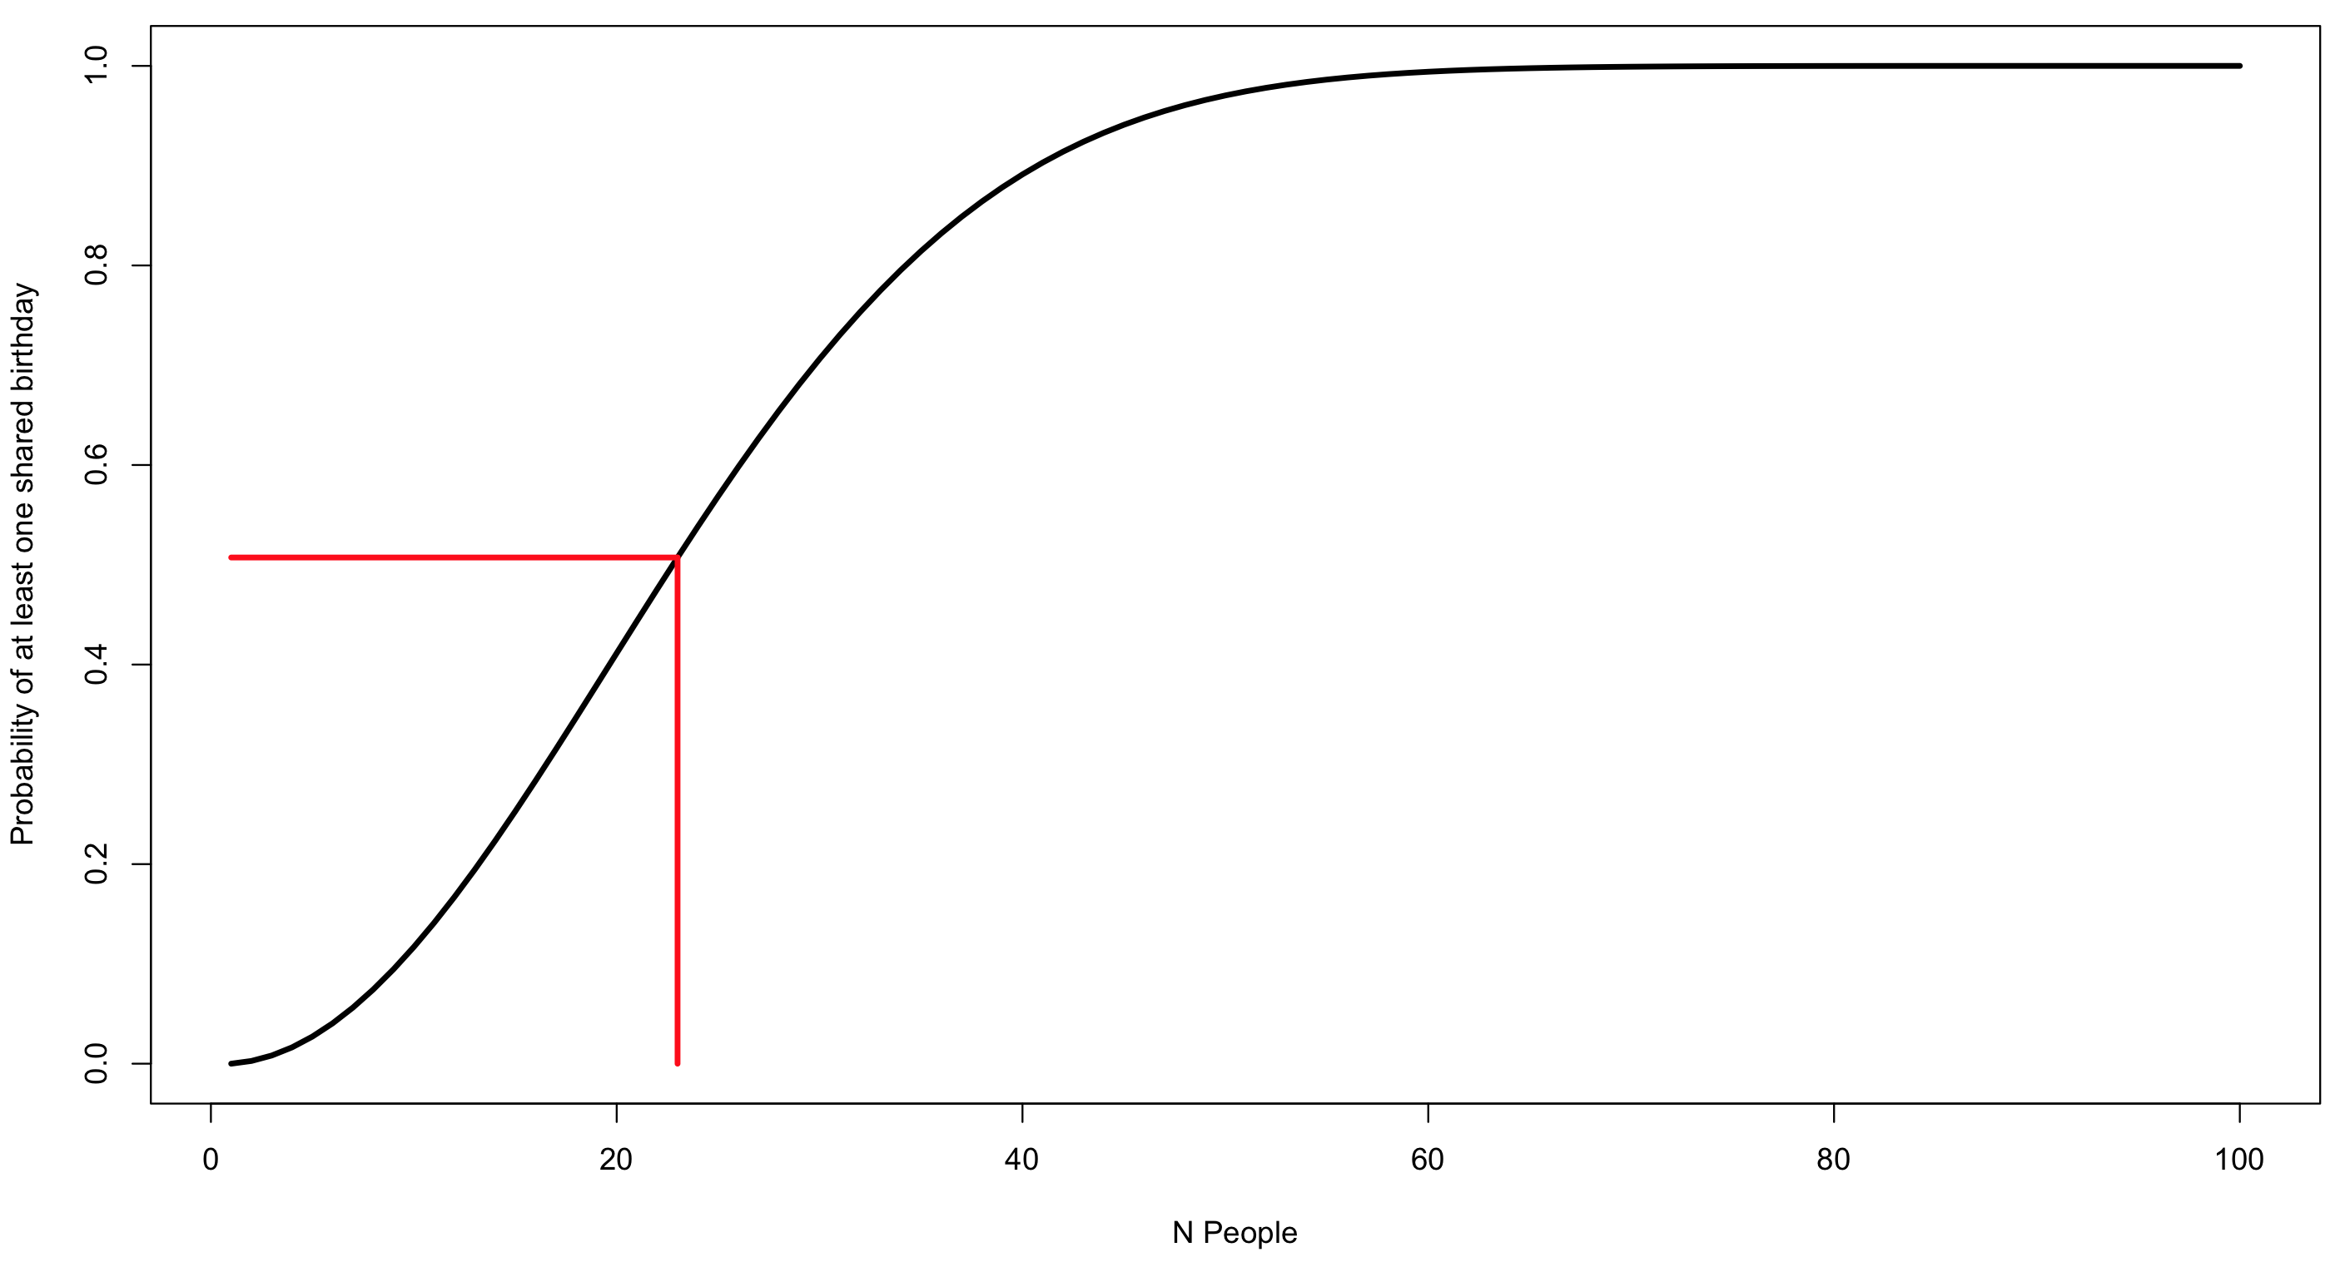
Exercise
Notes:
Graph of probabilities of two people sharing a birthday for N people

Slide 35
A blueprint for science
Notes:
This is not prescriptive, science can be done in other ways

Slide 36
A blueprint for science
Pick interesting question
Framed in form of a hypothesis
Notes:
Generally want to work on interesting questions, but must be testable

Slide 37
A blueprint for science
Pick interesting question
Framed in form of a hypothesis
Collect data
Measure at appropriate precision; avoid biased samples
Notes:
Data must be able to answer the question asked

Slide 38
A blueprint for science
Pick interesting question
Framed in form of a hypothesis
Collect data
Measure at appropriate precision; avoid biased samples
Perform statistics
Choose appropriate test; accept or reject hypothesis
Notes:
To avoid “making up” the answet we should apply an appropriate test with clear a priori interpretations of results

Slide 39
Null and alternative hypotheses

Slide 40
Null and alternative hypotheses
Null hypothesis – H_{null} / H₀
Simplest, boring, often stochastic explanation

Slide 41
Null and alternative hypotheses
Null hypothesis – H_{null} / H₀
Simplest, boring, often stochastic explanation
Alternative hypothesis – H_{alt} / H₁
Not the null, interesting, may incorporate multiple outcomes

Slide 42
Null and alternative hypotheses
H_{null} / H₀
H_{alt} / H₁
One-sample t-test
Two-sample t-test
ANOVA
Correlation

Slide 43
Null and alternative hypotheses
H_{null} / H₀
H_{alt} / H₁
One-sample t-test
CI_{low} < μ_{hyp.} < CI_{upp}
Two-sample t-test
ANOVA
Correlation

Slide 44
Null and alternative hypotheses
H_{null} / H₀
H_{alt} / H₁
μ_{hyp.} > CI_{upp} or
μ_{hyp.} < CI_{low}
One-sample t-test
CI_{low} < μ_{hyp.} < CI_{upp}
Two-sample t-test
ANOVA
Correlation

Slide 45
Null and alternative hypotheses
H_{null} / H₀
H_{alt} / H₁
μ_{hyp.} > CI_{upp} or
μ_{hyp.} < CI_{low}
One-sample t-test
CI_{low} < μ_{hyp.} < CI_{upp}
Two-sample t-test
μ_{A} = μ_{B}
ANOVA
Correlation

Slide 46
Null and alternative hypotheses
H_{null} / H₀
H_{alt} / H₁
μ_{hyp.} > CI_{upp} or
μ_{hyp.} < CI_{low}
One-sample t-test
CI_{low} < μ_{hyp.} < CI_{upp}
Two-sample t-test
μ_{A} = μ_{B}
μ_{A} < μ_{B} or μ_{A} > μ_{B}
ANOVA
Correlation

Slide 47
Null and alternative hypotheses
H_{null} / H₀
H_{alt} / H₁
μ_{hyp.} > CI_{upp} or
μ_{hyp.} < CI_{low}
One-sample t-test
CI_{low} < μ_{hyp.} < CI_{upp}
Two-sample t-test
μ_{A} = μ_{B}
μ_{A} < μ_{B} or μ_{A} > μ_{B}
ANOVA
μ_{A} = μ_{B} = μ_{C}…
Correlation

Slide 48
Null and alternative hypotheses
H_{null} / H₀
H_{alt} / H₁
μ_{hyp.} > CI_{upp} or
μ_{hyp.} < CI_{low}
One-sample t-test
CI_{low} < μ_{hyp.} < CI_{upp}
Two-sample t-test
μ_{A} = μ_{B}
μ_{A} < μ_{B} or μ_{A} > μ_{B}
ANOVA
μ_{A} = μ_{B} = μ_{C}…
μ_{A} > μ_{B} = μ_{C} or...
Correlation

Slide 49
Null and alternative hypotheses
H_{null} / H₀
H_{alt} / H₁
μ_{hyp.} > CI_{upp} or
μ_{hyp.} < CI_{low}
One-sample t-test
CI_{low} < μ_{hyp.} < CI_{upp}
Two-sample t-test
μ_{A} = μ_{B}
μ_{A} < μ_{B} or μ_{A} > μ_{B}
ANOVA
μ_{A} = μ_{B} = μ_{C}…
μ_{A} > μ_{B} = μ_{C} or...
Correlation
r = 0

Slide 50
Null and alternative hypotheses
H_{null} / H₀
H_{alt} / H₁
μ_{hyp.} > CI_{upp} or
μ_{hyp.} < CI_{low}
One-sample t-test
CI_{low} < μ_{hyp.} < CI_{upp}
Two-sample t-test
μ_{A} = μ_{B}
μ_{A} < μ_{B} or μ_{A} > μ_{B}
ANOVA
μ_{A} = μ_{B} = μ_{C}…
μ_{A} > μ_{B} = μ_{C} or...
Correlation
r = 0
r > 0 or r < 0

Slide 51
Choosing a hypothesis
Significance-level
Decides threshold value between accepting or rejecting null; termed alpha

Slide 52
Choosing a hypothesis
Significance-level
Decides threshold value between accepting or rejecting null; termed alpha
Confidence-level
One minus alpha; often expressed as a percentage

Slide 53
Choosing a hypothesis
One-tailed
Only care whether value falls to left or right of alpha

Slide 54
Choosing a hypothesis
One-tailed
Only care whether value falls to left or right of alpha
Two-tailed
Allow alpha to be split equally in two; accounts for higher and lower values

Slide 55
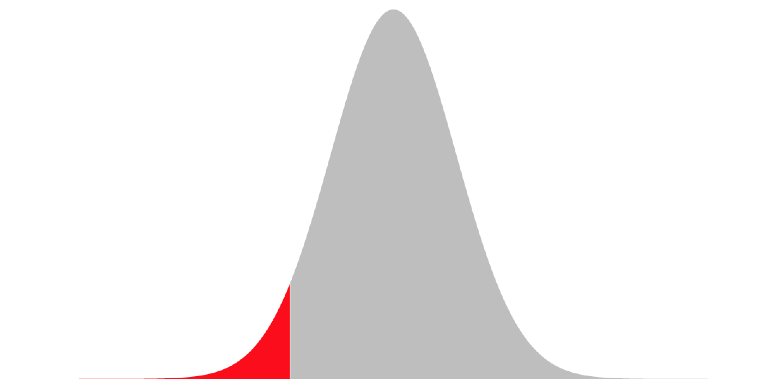
Choosing a hypothesis
Left-tailed
α
H₁
H₀

Slide 56
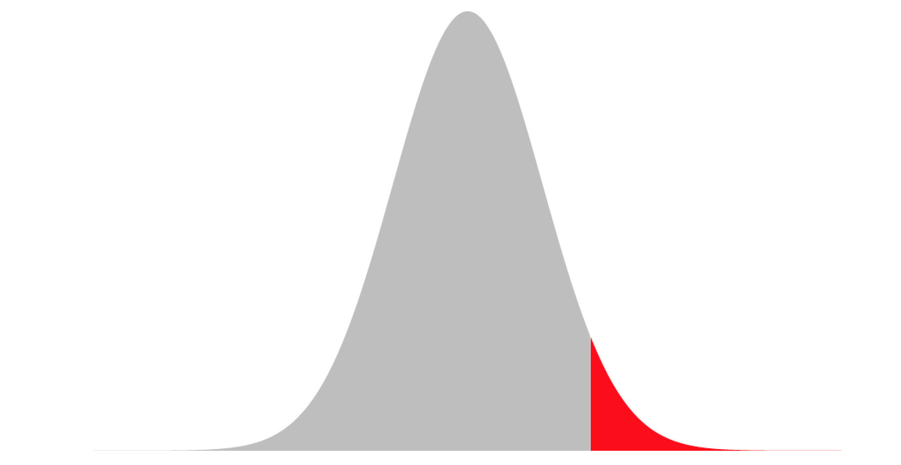
Choosing a hypothesis
Left-tailed
Right-tailed
α
α
H₁
H₀
H₀
H₁

Slide 57
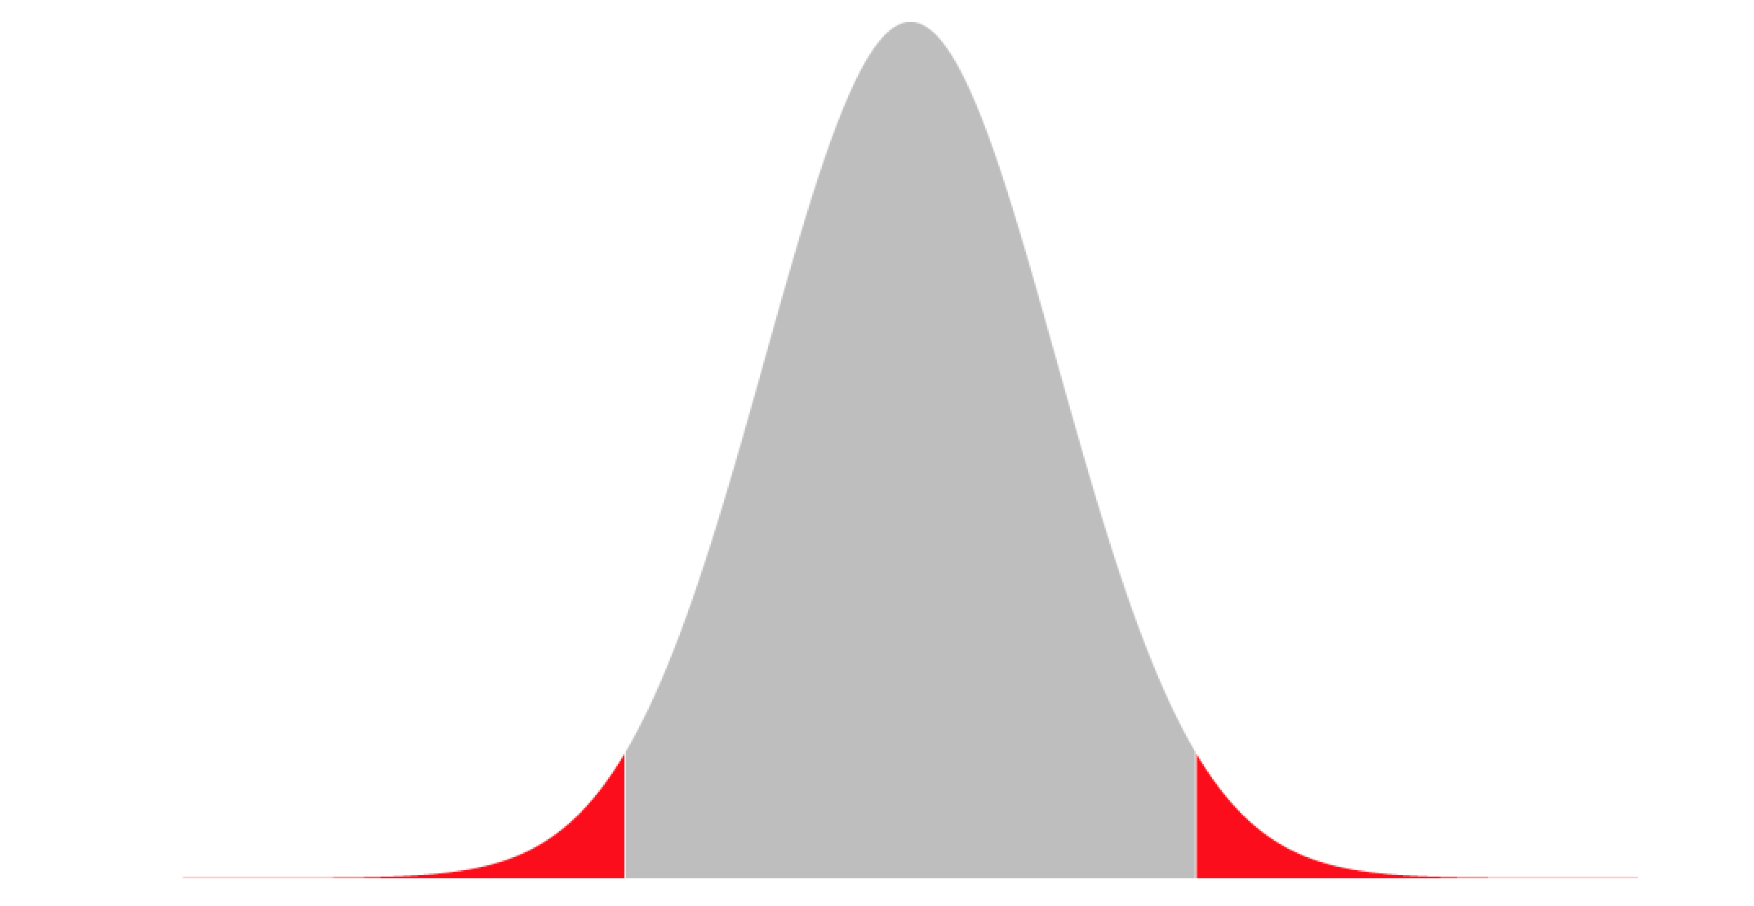
Choosing a hypothesis
Left-tailed
Right-tailed
Two-tailed
α
α
α/2
α/2
H₁
H₀
H₀
H₁
H₁
H₀
H₁

Slide 58
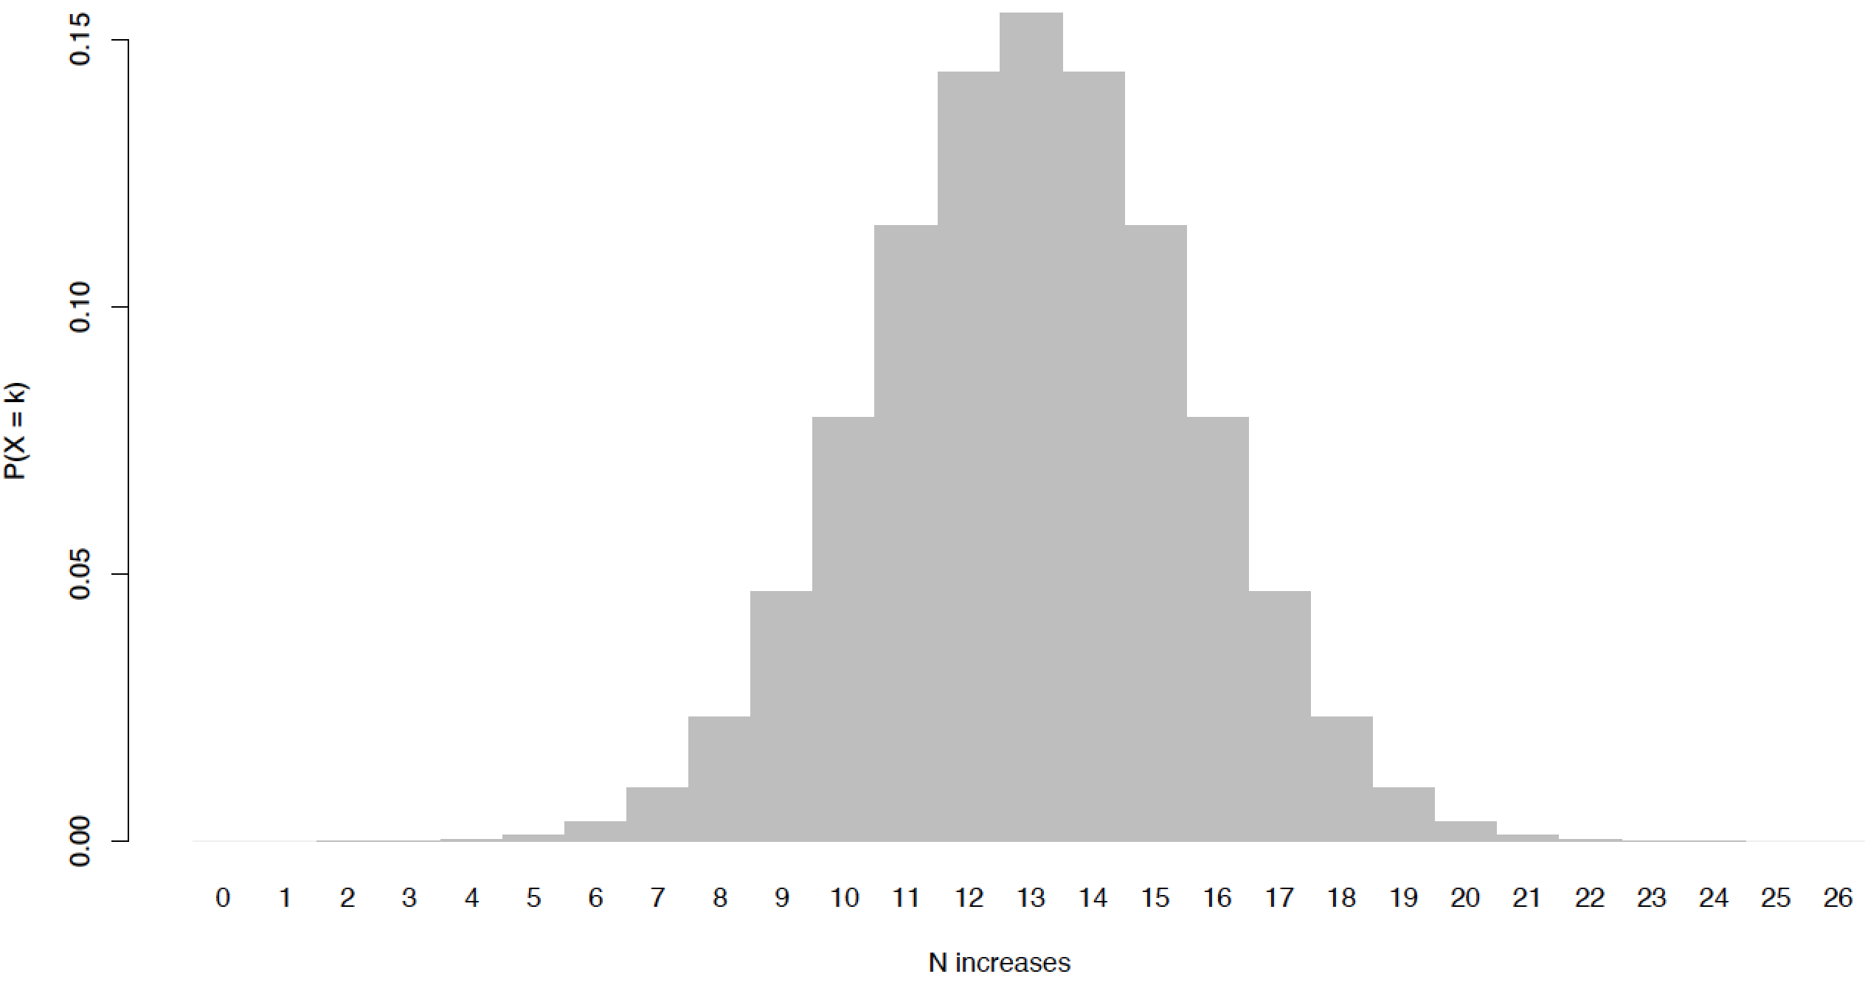
Choosing a hypothesis

Slide 59
Choosing a hypothesis
α = 0.5
(Two-tailed test)
CI = 0.5

Slide 60
Choosing a hypothesis
α = 0.5
(Two-tailed test)
CI = 0.5
H₀
≈

Slide 61
Choosing a hypothesis
α = 0.5
(Two-tailed test)
CI = 0.5
H₁
H₀
H₁
>
≈
>

Slide 62
Choosing a hypothesis
α = 0.5
(Two-tailed test)
CI = 0.5
H₁
H₀
H₁
>
≈
>

Slide 63
Choosing a hypothesis
α = 0.5
(Two-tailed test)
CI = 0.5
Accept H₀
H₁
H₀
H₁
>
≈
>

Slide 64
Choosing a hypothesis
Type I error
Rejecting the null when the null is correct (false positive)

Slide 65
Choosing a hypothesis
Type I error
Rejecting the null when the null is correct (false positive)
Type II error
Accepting the null when the null is incorrect (false negative)

Slide 66
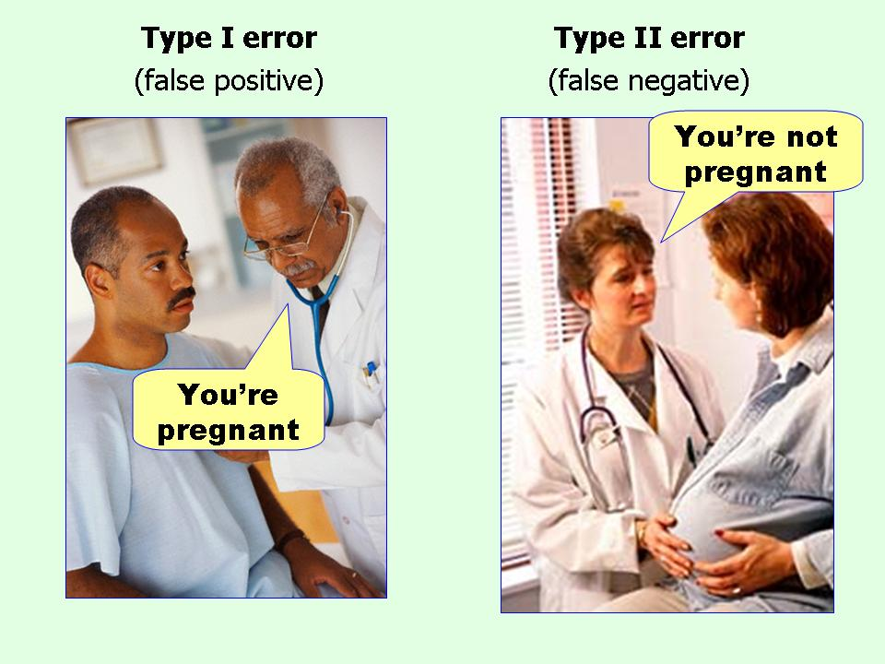
Type I and Type II errors
Type I error
False positive

Slide 67
Type I and Type II errors
Type I error
Type II error
False positive
False negative

Slide 68
Problems with null hypothesis tests

Slide 69
Problems with null hypothesis tests
Choosing alpha
No clear ideal value

Slide 70
Problems with null hypothesis tests
Choosing alpha
No clear ideal value
Counterintuitive
Typically about low probability of model we believe is incorrect

Slide 71
Problems with null hypothesis tests
Choosing alpha
No clear ideal value
Counterintuitive
Typically about low probability of model we believe is incorrect
Sample size dependency
Low sample sizes frequently lead to Type II errors

Slide 72
Alternatives to null hypotheses
Maximum likelihood
Most likely value or model regardless of absolute probability

Slide 73
Alternatives to null hypotheses
Maximum likelihood
Most likely value or model regardless of absolute probability
Bayesian statistics
Expresses probabilities as degrees of belief that update with new data

Slide 74
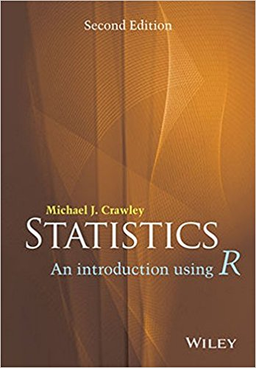
Reading
Statistics An Introduction
Using R
Crawley

Slide 75

Reading
Statistics An Introduction
Using R
Crawley
Bad Science
Goldacre

Slide 76

Reading
Statistics An Introduction
Using R
Crawley
The Numbers Game
Anderson
and Sally
Bad Science
Goldacre

Slide 77

Reading
Statistics An Introduction
Using R
Crawley
The Numbers Game
Anderson
and Sally
The Theory That Would Not Die
McGrayne
Bad Science
Goldacre

Slide 78

Reading
Statistics An Introduction
Using R
Crawley
The Numbers Game
Anderson
and Sally
The Theory That Would Not Die
McGrayne
Bad Science
Goldacre
Flatland
Abbott

Slide 79
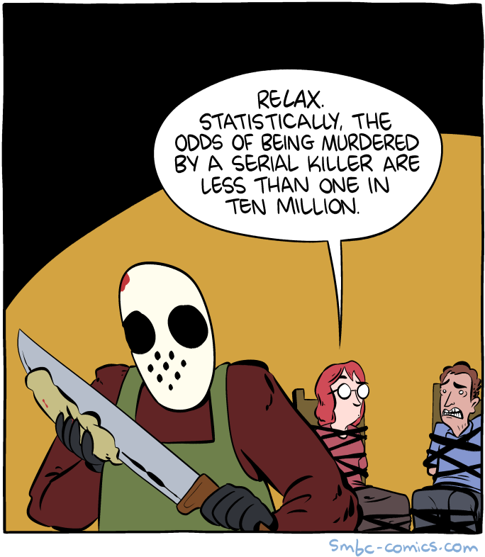
Web comics
Saturday Morning
Breakfast Cereal

Slide 80
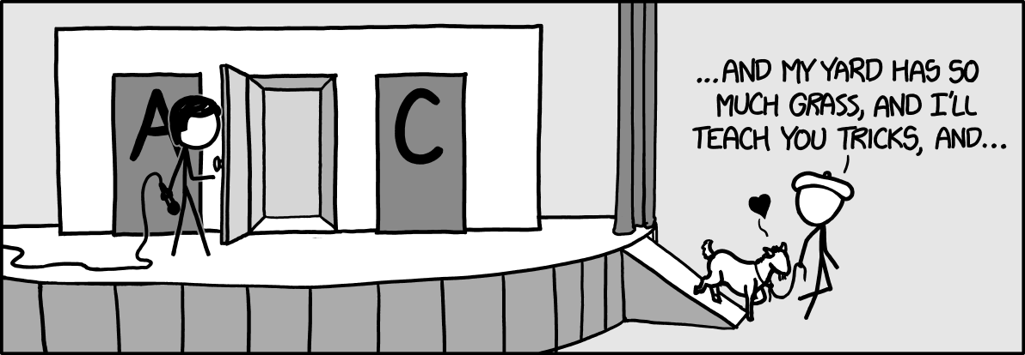
Web comics
Saturday Morning
Breakfast Cereal
xkcd

